Slide 1
MVP/ Go Play
Project 2 – Miquon, Craig, Andrew, Valerie

Slide 2
Our Concept
A social app for event creation/management and finding participants
1. Who is your target audience?
Anyone looking for a way to share their event ideas and find participants!
2. What is the problem that the product will address?
3. What is the primary goal of the product?
Want to do something but don’t have people to do it with.
Don’t want to keep track of group chats or emails.
Perhaps your friends aren’t interested in the same events as you.
An easy, centralized interface to propose event ideas, find & manage interested parties, and find events of interest

Slide 3
User Stories
Identify and prioritize essential user stories (limit this to 3 or fewer)
1. As a user, I want to create events (trips, games, sports, etc) and find people who want to participate
2. As a user, I want to be able to search for other events and join them
3. As a user, I want to be able to have one central location to manage my social events

Slide 4
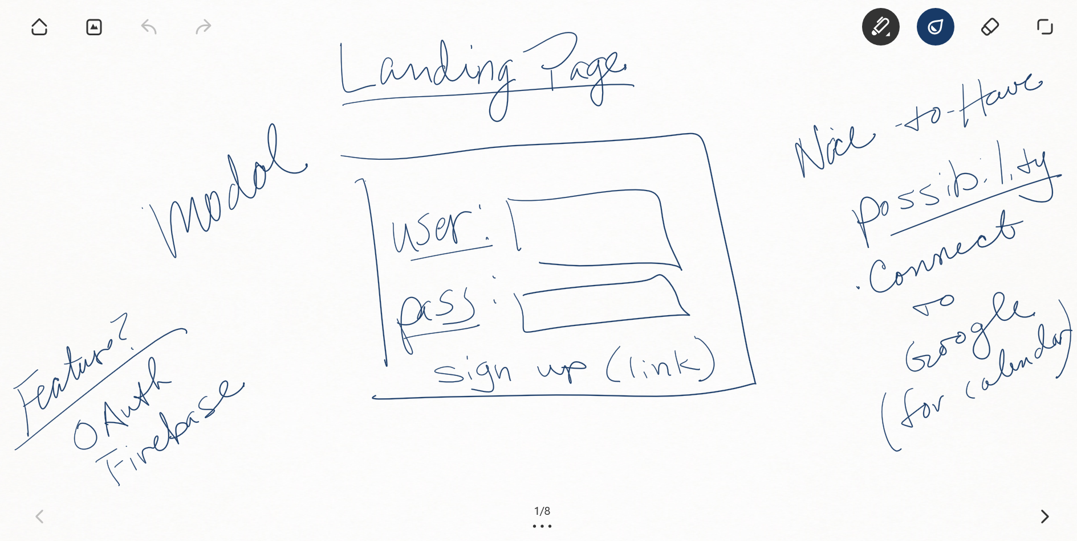
Sign In Page

Slide 5
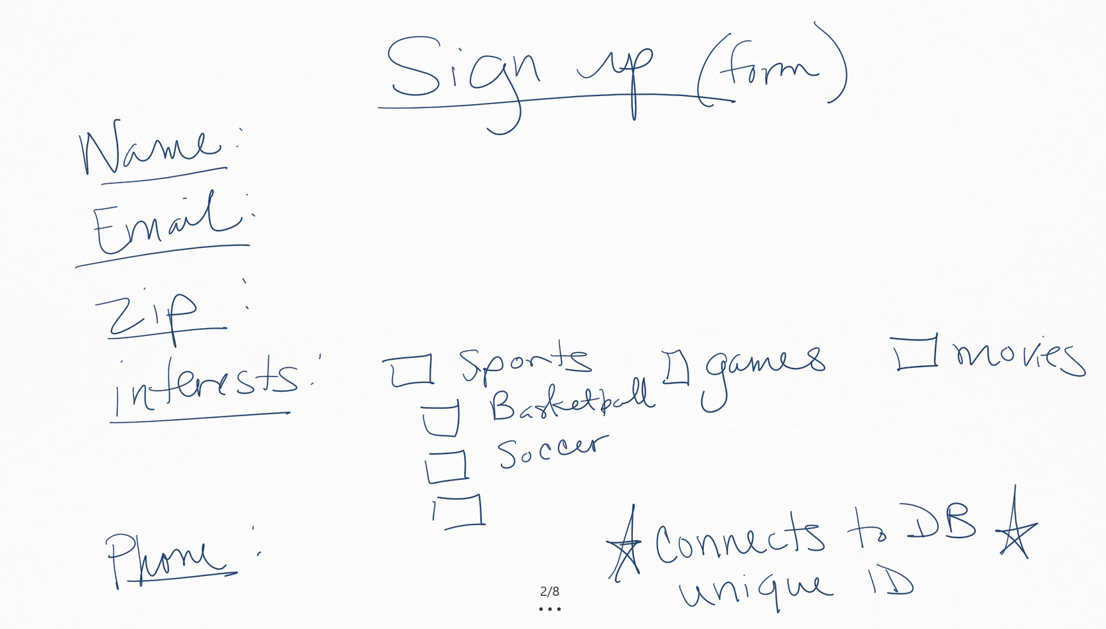
Sign Up Page

Slide 6
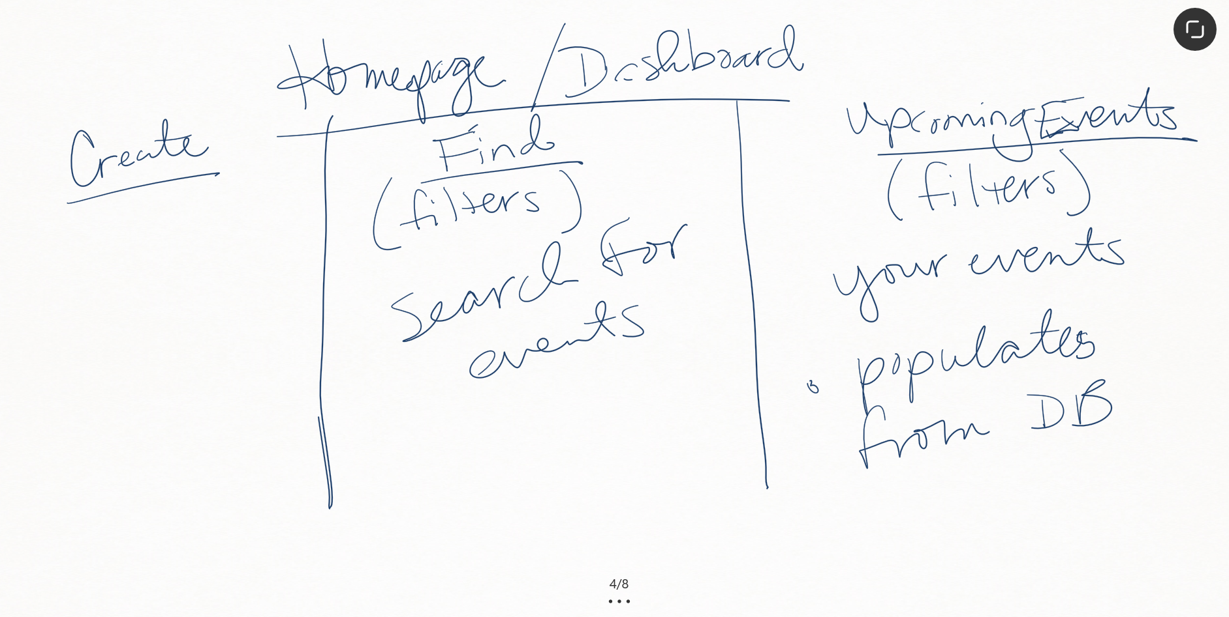
Dashboard

Slide 7
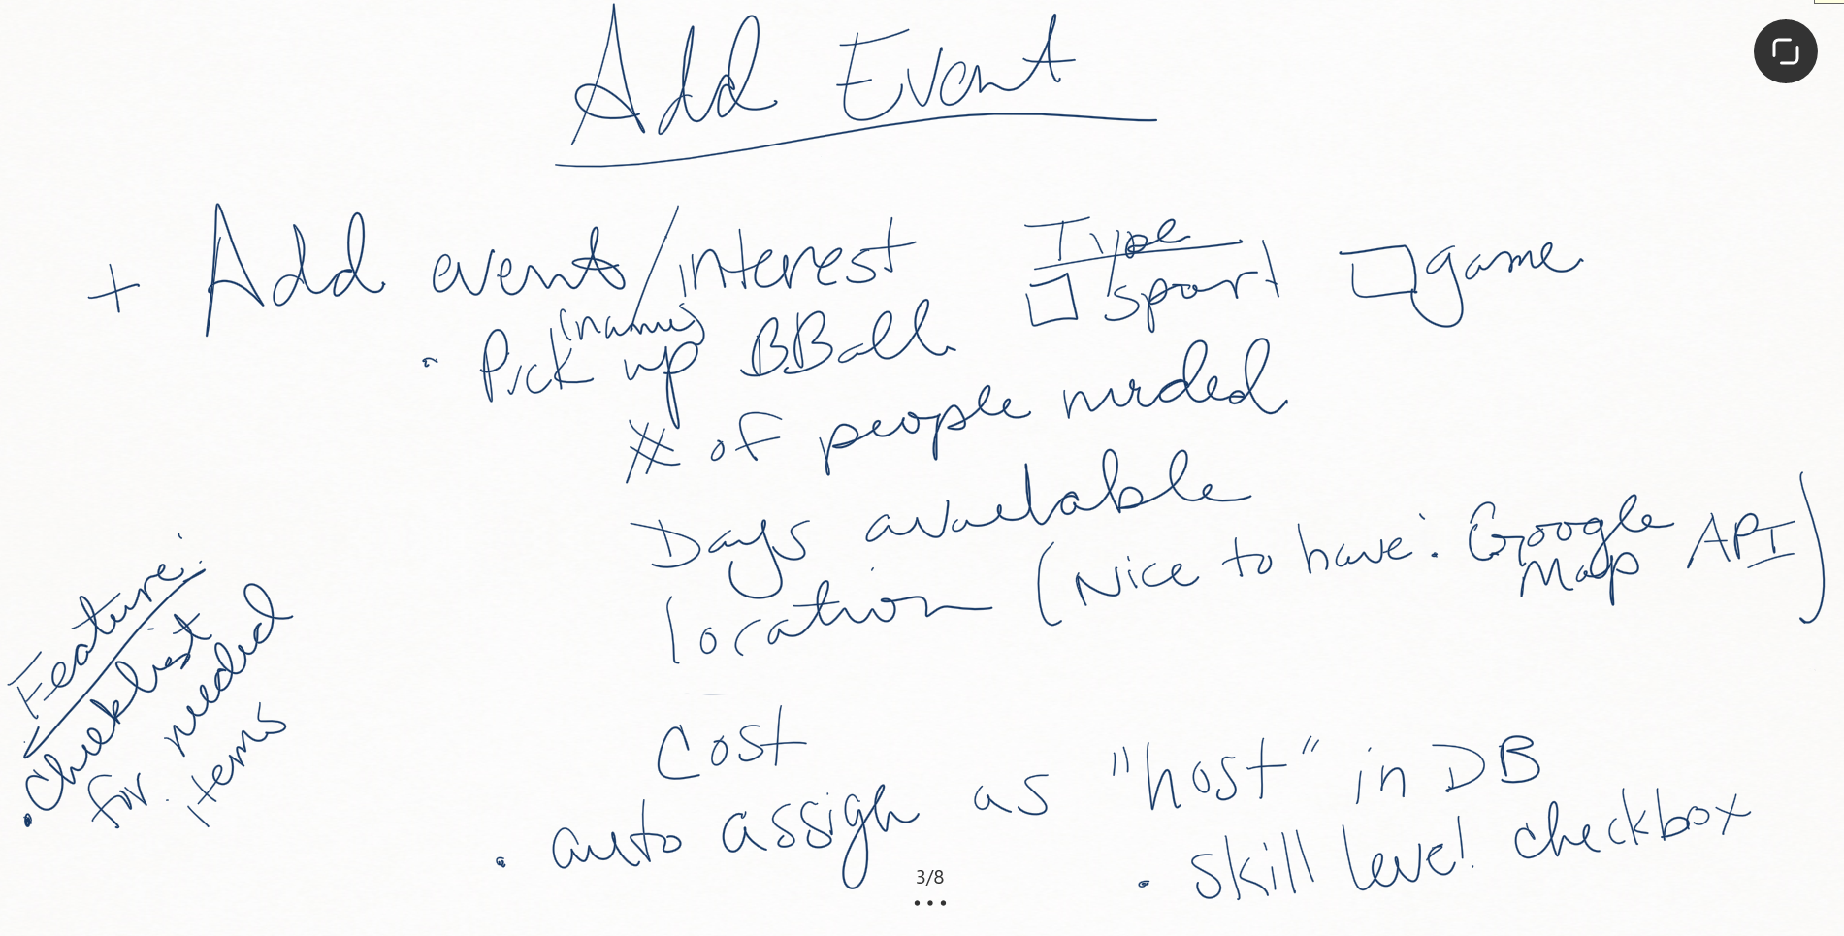
Create/Add Event

Slide 8
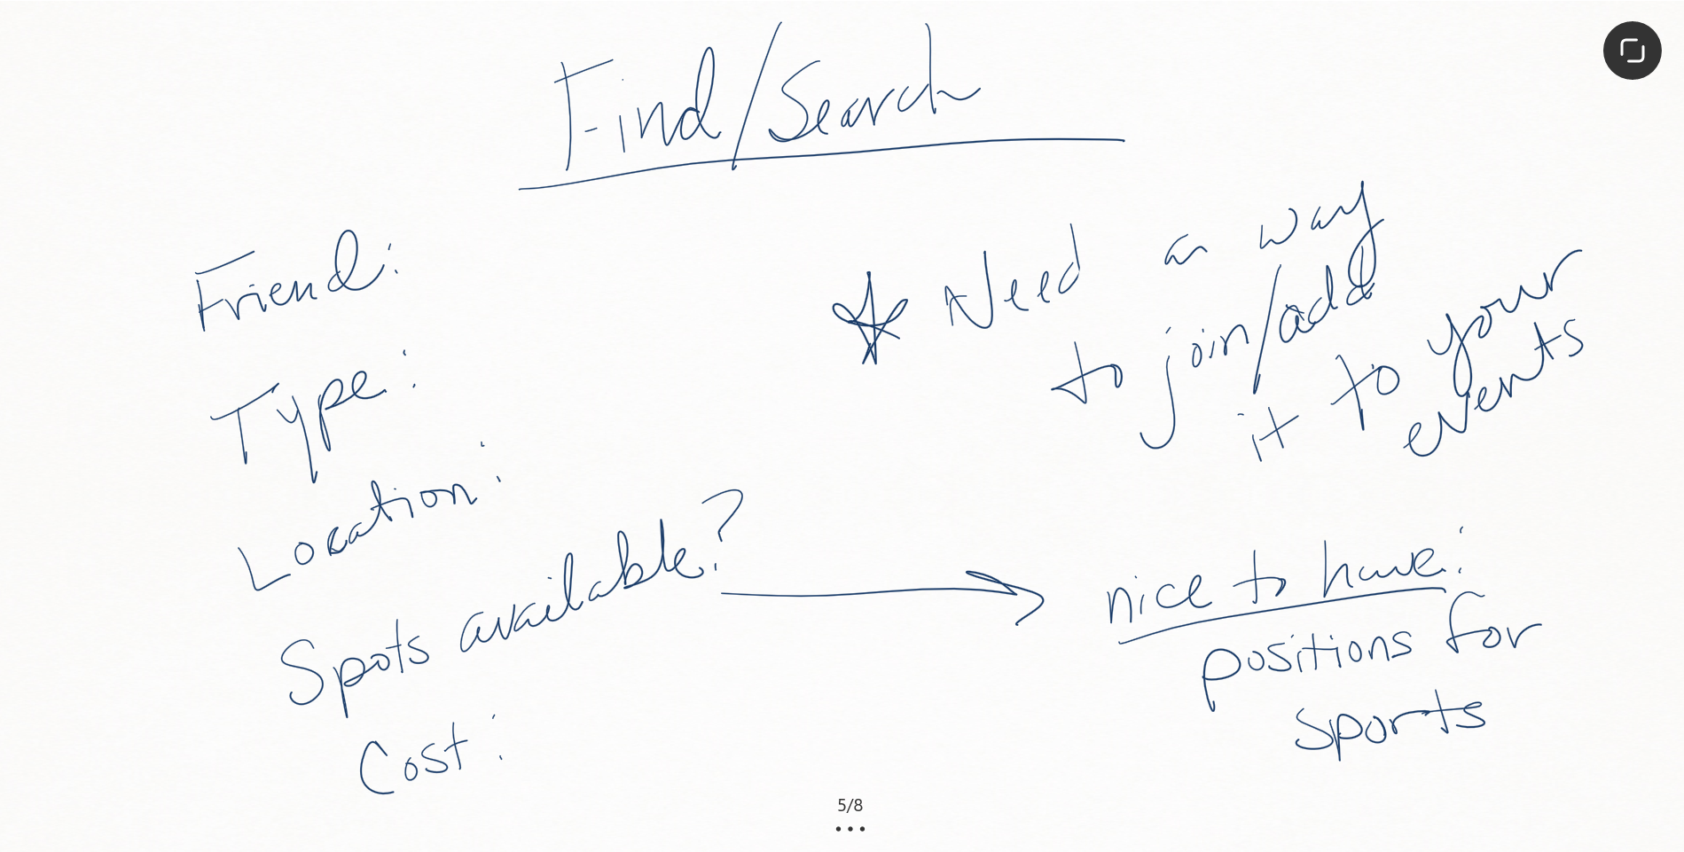
Find Events

Slide 9
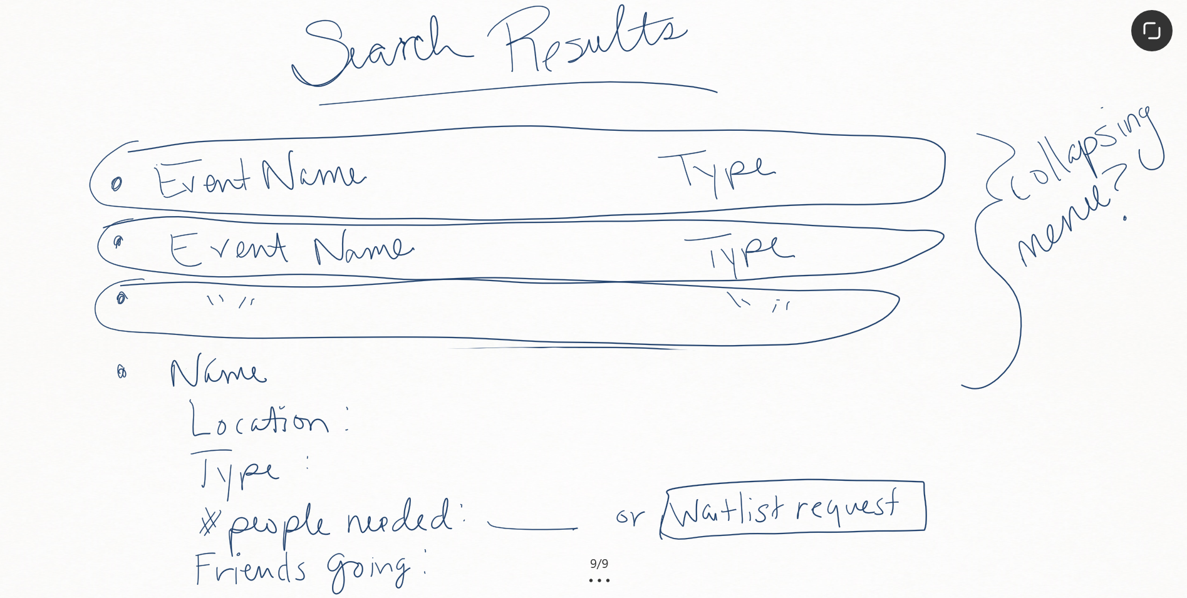
Search Results

Slide 10
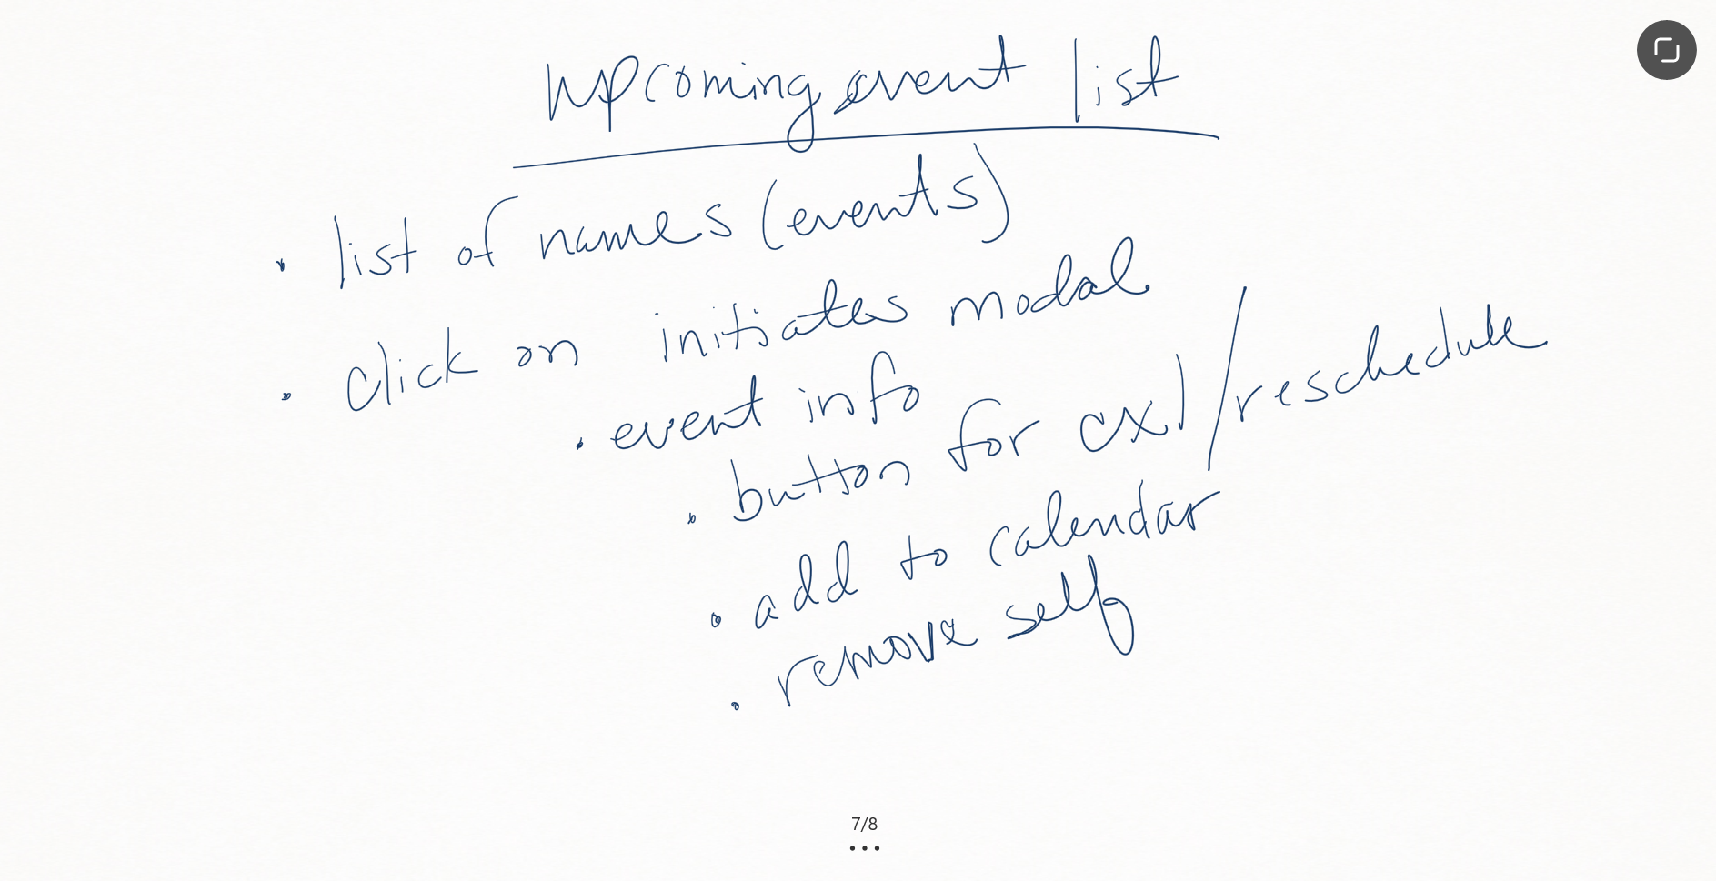
Upcoming Events

Slide 11
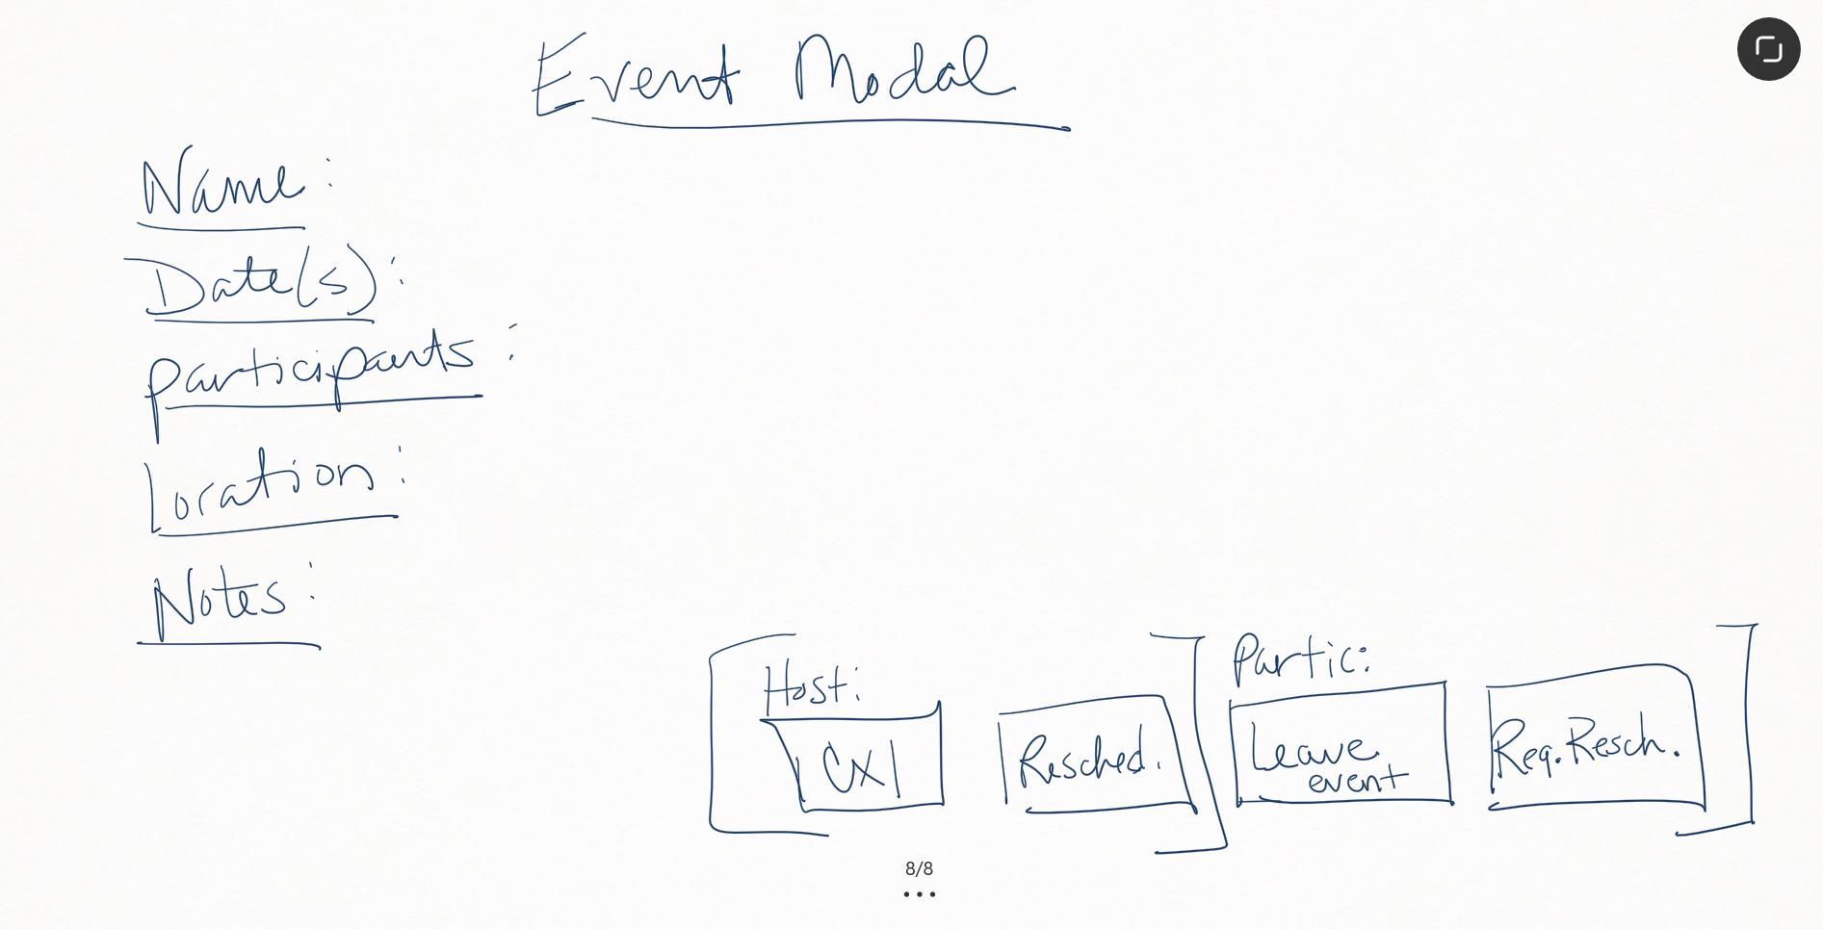
Event Modals

